Slide 1
Career Authentic Performance Tasks: Tom Skjervheim Senior Program Associate
Esther Soliman
Linked Learning Director, LAUSD
Notes:
Intro-overview

Slide 2
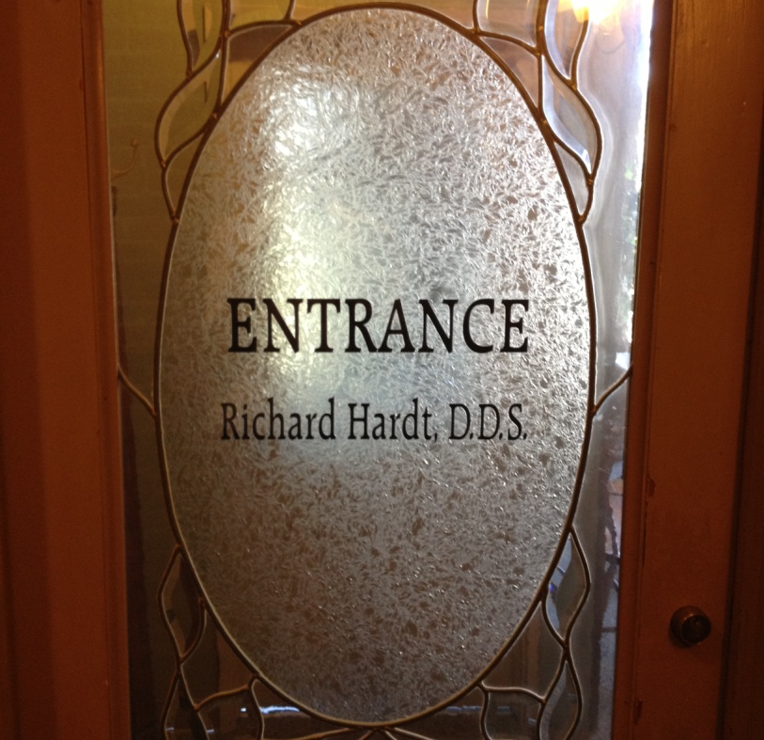
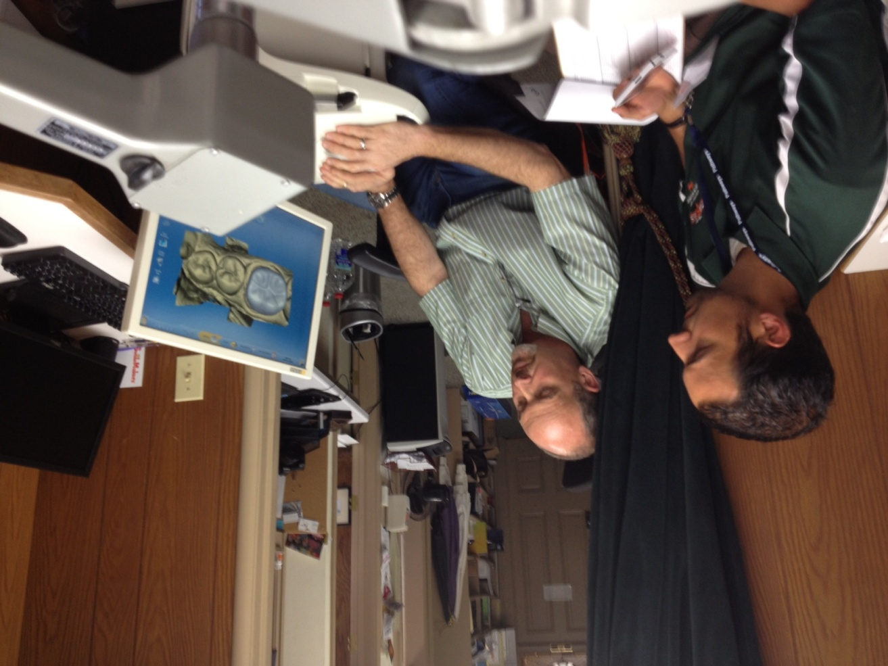
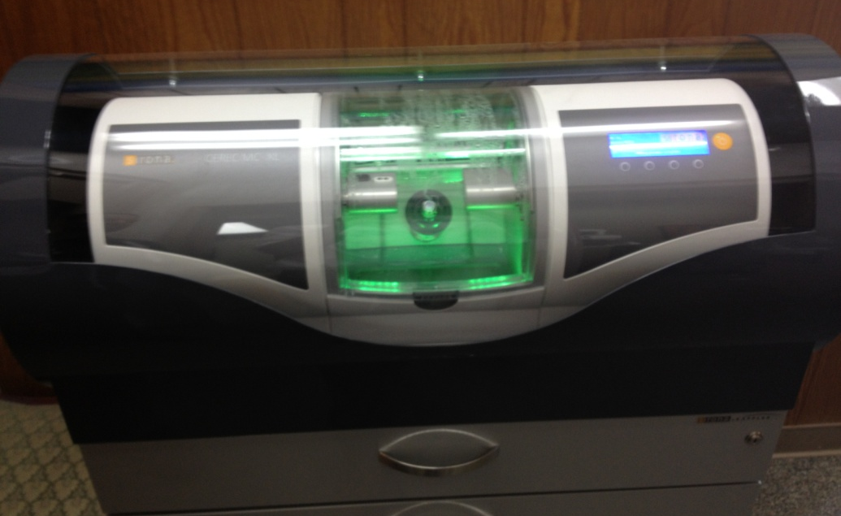
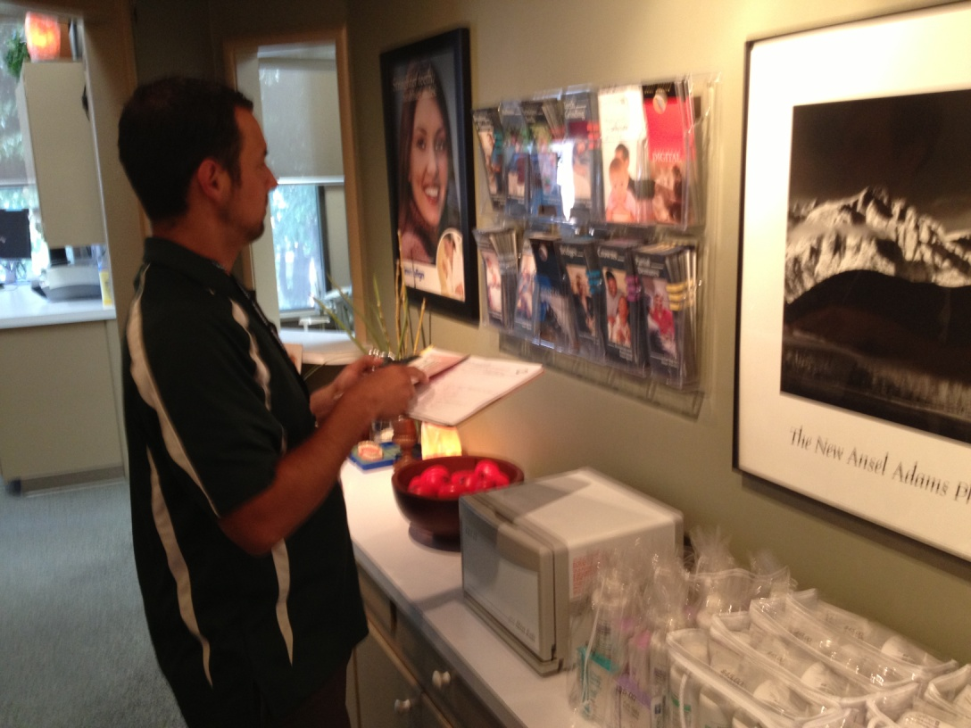
Porterville: Summer 2013 PD “Real-World” Performance Tasks Aligned to CCSS

Slide 3
Porterville: Job Shadow to Performance Task
Complete “Job Shadow” (short visit/interview) in industry aligned to pathway career theme
Prototype performance task aligned to:
Common Core State Standards (CCSS)
District Graduate Profile Outcomes:
Critical Thinking & Problem Solving
Effective Communication Skills of Listening, Speaking, & Writing
Cultural Awareness & Ability to Collaborate w/ Diverse Groups

Slide 4
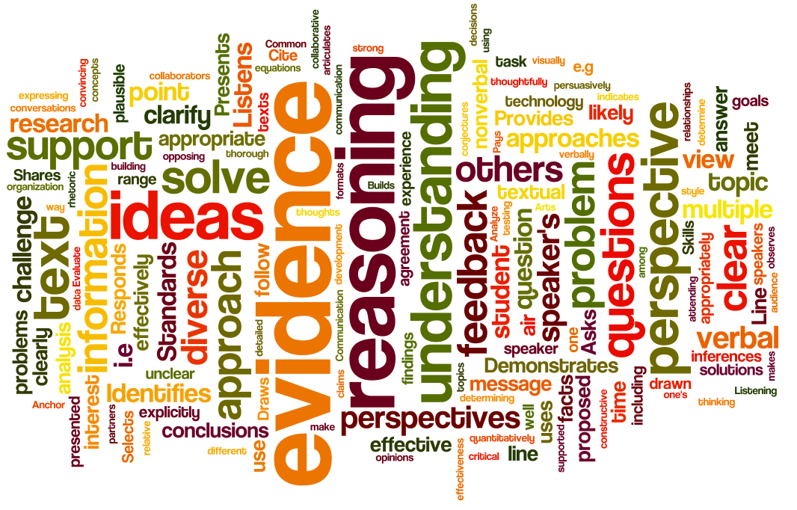
Assessing Career Readiness & CCSS Simultaneously

Slide 5
Modelling Our Process
ConnectEd (& Consultant) Staff – Job Shadow to Cooperative Graphic Design Firm - Oakland
Tips for Job Shadow/Interview:
Ask for/collect actual documents used by professionals in this workplace
Probe for connections to high school program of study (CTE & Academic)
Dig deep into specific areas of the industry partner’s practice
Specifically looking for connections to graduate profile outcomes (problem solving, analysis, communication, collaboration)
Notes:
Marc and I visited an Oakland-based cooperatively owned graphic design firm and interviewed them about the higher order thinking skills used at their workplace
We then returned and prototyped a performance task to model the process, but more importantly to engage the teacher teams in an example of HOW a job shadow might yield a truly authentic and rigorous performance task

Slide 6
Outcomes for the Next Hour
Learn and Analyze by Doing…
Engage in performance task prototype
Reflect upon a real-world, performance task design process
Unpack implications for task design, assessment, and alignment to CCSS

Slide 7
Your Task
Step 1: Break up into a team of 4
Step 2: Read over the performance task; determine the challenge posed to you; discuss with team (35 min.)
Step 3: If possible, come to consensus as a team regarding the solution to challenge. If consensus is not possible, identify most important factors influencing decision.
Step 4: Select one team member who will present a potential solution, key factors, to another team (5 min.)

